Slide 1
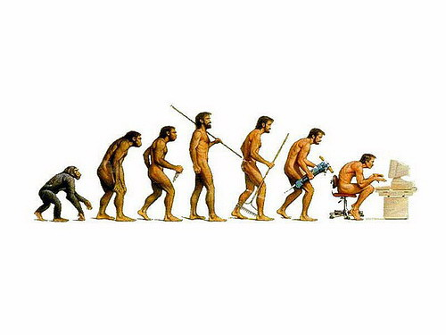
Genetic Algorithms

Slide 2
How do you find a solution in a large complex space?
Ask an expert?
Adapt existing designs?
Trial and error?
Notes:
What has been traditionally done in the heat exchanger world is to take a best “guess” at a design with the help of an expert. Traditional heat exchanger designs are usually fully mathematically described.
This initial guess can then be used as a basis, and various parameters are “tweaked”. The performance of the heat exchanger can be recalculated to see if the modified design is an improvement on the original one.
Surely there must be a better way? There is - we don’t need to look very far to find examples of optimisation in Nature.

Slide 3


Example: Traveling Sales Person (TSP)
Classic Example: You have N cities, find the shortest route such that your salesperson will visit each city once and return.
This problem is known to be NP-Hard
As a new city is added to the problem, computation time in the classic solution increases exponentially O(2^{n}) … (as far as we know)
Dallas
Is this the shortest path???
Austin
Houston
Mos Eisley
San Antonio
A Texas Sales Person

Slide 4
What if………
Lets create a whole bunch of random sales people and see how well they do and pick the best one(s).
Salesperson A
Houston -> Dallas -> Austin -> San Antonio -> Mos Eisely
Distance Traveled 780 Km
Salesperson B
Houston -> Mos Eisley -> Austin -> San Antonio -> Dallas
Distance Traveled 820 Km
Salesperson A is better (more fit) than salesperson B
Perhaps we would like sales people to be more like A and less like B
Question:
do we want to just keep picking random sales people like this and keep testing them?

Slide 5
We can get a little closer to the solution in polynomial time
We might use a heuristic(s) to guide us in creating new sales people
So for instance, we might use the triangle inequality to help pick better potential sales people.
One can create an initial 2 approximation (at worst the distance is twice the optimal distance) to TSP using a Nearest Neighbor or other similar efficient polynomial time method.
This detail is somewhat unimportant, you can use all kinds of heuristics to help you create a better initial set of sales people [e.g. Match Twice and Stitch (Kahng, Reda 2004)].
Use some sort of incremental improvement make them better successively.
The idea is that you start with result(s) closer to where you think the solution is than one would obtain at random so that the problem converges more quickly.
Be careful since an initial approximation may be too close to a local extrema which might actually slow down convergence or throw the solution off.

Slide 6
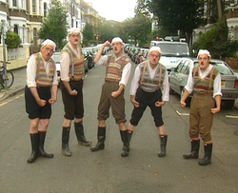
However…………
Sales person A is better than sales person B, but we can imagine that is would be easy to create a sales person C who is even better.
We don’t want to create 2^{n} sales people!
This is a lecture about genetic algorithms (GA), <sarcasm> what kind of solution will we use?</sarcasm>
Should we try a genetic algorithm solution???
Really? Are you sure? Maybe we should try something else
It might be that you would prefer another solution
I mean it might not be a bad idea
You might learn something new
However it might not be all the exciting
I’m kind of not sure
My mother suggested that I should do something else
But at any rate I suppose you would like to get on with it
Ok if you insist, but it’s all on your hands!
Randomly inserted image
for no reason at all

Slide 7
Represent problem like a DNA sequence
Each DNA sequence is a
possible solution to the
problem.
DNA - Salesperson A
Dallas
Houston
Mos Eisely
San Antonio
Austin
San Antonio
Dallas
Mos Eisely
Houston
Austin
The order of the cities in
the genes is the order of
the cities the TSP will take.
DNA - Salesperson B
Notes:
One the fitness has been assigned, pairs of chromosomes representing heat exchanger designs can be chosen for mating.
The higher the fitness, the greater the probability of the design being selected. Consequently, some of the weaker population members do not mate at all, whilst superior ones are chosen many times.
It is even statistically possible for a member to be chosen to mate with itself. This has no advantage, as the offspring will be identical to the parent.

Slide 8
Ranking by Fitness:
Here we’ve created three
different salespeople. We
then checked to see how
far each one has to travel.
This gives us a measure of
“Fitness”
Note: we need to be able to measure fitness in polynomial time, otherwise we are in trouble.
Travels Shortest Distance
Notes:
One the population has been formed, (either randomly in the initial generation, or by mating in subsequent generations), each population member needs to be assessed against the desired properties - such a rating is called a “fitness”.
The design parameters represented by the zeros and ones in the binary code of each chromosome are fed into the mathematical model describing the heat exchanger. The output parameters for each design are used to give the fitness rating. A good design has a high fitness value, and a poor design a lower value.

Slide 9
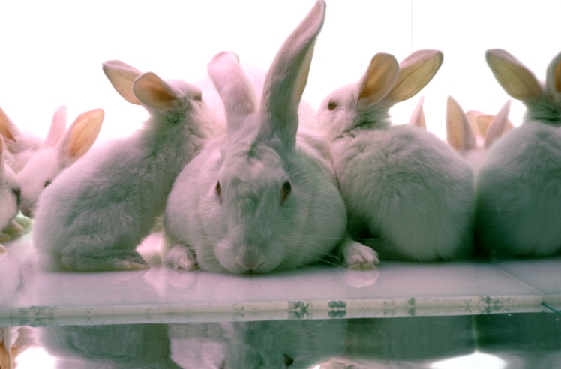
Let’s breed them!
We have a population of traveling sales people. We also know their fitness based on how long their trip is. We want to create more, but we don’t want to create too many.
We take the notion that the salespeople who perform better are closer to the optimal salesperson than the ones which performed more poorly. Could the optimal sales person be a “combination” of the better sales people?
We create a population of sales people as solutions to the problem.
How do we actually mate a population of data???

Slide 10
Crossover: Exchanging information through some part of information (representation)
Once we have found the best sales people we will in a sense mate them. We can do this in several ways. Better sales people should mate more often and poor sales people should mate lest often.
Sales person A (parent 1)
Sales person B (parent 2)
Sales People | City DNA
Parent 1 | F A B | E C G D
Parent 2 | D E A | C G B F
Child 1 | F A B | C G B F
Child 2 | D E A | E C G D
Sales person C (child 1)
Sales person D (child 2)
Notes:
The mating process is analogous to crossover carried out in living cells.
A pair of binary strings are used. A site along the length of the string is chosen randomly. In this example it is shown between the 6th and 7th bits, but it could be anywhere.
Both members of the pair are severed at that site, and their latter portions are exchanged. Two parents form two children, and these two “daughter” designs become members of the population for the next generation.
This process takes place for each pair selected, so the new population has the same number of members as the previous generation.

Slide 11
Crossover Bounds (Houston we have a problem)
Not all crossed pairs are viable. We can only visit a city once.
Different GA problems may have different bounds.
Parents
Children
Dallas
Houston
Austin
San Antonio
Mos Eisely
San Antonio
Dallas
Mos Eisely
Houston
Austin
San Antonio
Dallas
Austin
San Antonio
Mos Eisely
Dallas
Houston
Mos Eisely
Houston
Austin
Not Viable!!

Slide 12
TSP needs some special rules for crossover
Many GA problems also need special crossover rules.
Since each genetic sequence contains all the cities in the travel, crossover is a swapping of travel order.
Remember that crossover also needs to be efficient.
Parents
Children
Dallas
Houston
Austin
San Antonio
Mos Eisely
San Antonio
Dallas
Mos Eisely
Houston
Austin
San Antonio
Dallas
Houston
Austin
Mos Eisely
Dallas
Mos Eisely
Houston
San
Antonio
Austin
Viable ☺

Slide 13

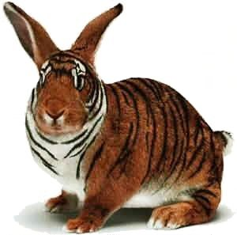
What about local extrema?
With just crossover breading, we are constrained to gene sequences which are a cross product of our current population.
Introduce random effects into our population.
Mutation – Randomly twiddle the genes with some probability.
Cataclysm – Kill off n% of your population and create fresh new salespeople if it looks like you are reaching a local minimum.
Annealing of Mating Pairs – Accept the mating of suboptimal pairs with some probability.
Etc…

Slide 14
In summation: The GA Cycle
New Population
Fitness
Mutation
Selection
Crossover
Notes:
Summary of the previous steps to the model.
Populations are continuously produced, going round the outer loop of this diagram, until the desired amount of optimisation has been achieved.

Slide 15
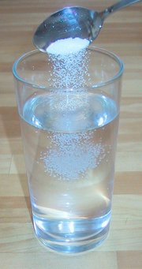
GA and TSP: the claims
Can solve for over 3500 cities (still took over 1 CPU years).
Maybe holds the record.
Will get within 2% of the optimal solution.
This means that it’s not a solution per se, but is an approximation.

Slide 16
GA Discussion
We can apply the GA solution to any problem where the we can represent the problems solution (even very abstractly) as a string.
We can create strings of:
Digits
Labels
Pointers
Code Blocks – This creates new programs from strung together blocks of code. The key is to make sure the code can run.
Whole Programs – Modules or complete programs can be strung together in a series. We can also re-arrange the linkages between programs.
The last two are examples of Genetic Programming

Slide 17
Things to consider
How large is your population?
A large population will take more time to run (you have to test each member for fitness!).
A large population will cover more bases at once.
How do you select your initial population?
You might create a population of approximate solutions. However, some approximations might start you in the wrong position with too much bias.
How will you cross bread your population?
You want to cross bread and select for your best specimens.
Too strict: You will tend towards local minima
Too lax: Your problem will converge slower
How will you mutate your population?
Too little: your problem will tend to get stuck in local minima
Too much: your population will fill with noise and not settle.

Slide 18
GA is a good no clue approach to problem solving
GA is superb if:
Your space is loaded with lots of weird bumps and local minima.
GA tends to spread out and test a larger subset of your space than many other types of learning/optimization algorithms.
You don’t quite understand the underlying process of your problem space.
NO I DONT: What makes the stock market work??? Don’t know? Me neither! Stock market prediction might thus be good for a GA.
YES I DO: Want to make a program to predict people’s height from personality factors? This might be a Gaussian process and a good candidate for statistical methods which are more efficient.
You have lots of processors
GA’s parallelize very easily!

Slide 19
Why not use GA?
Creating generations of samples and cross breading them can be resource intensive.
Some problems may be better solved by a general gradient descent method which uses less resource.
However, resource-wise, GA is still quite efficient (no computation of derivatives, etc).
In general if you know the mathematics, shape or underlying process of your problem space, there may be a better solution designed for your specific need.
Consider Kernel Based Learning and Support Vector Machines?
Consider Neural Networks?
Consider Traditional Polynomial Time Algorithms?
Etc.

